Slide 1
Module 2 – Syntax Analysis

Slide 2
Left recursion & Left factoring

Slide 3



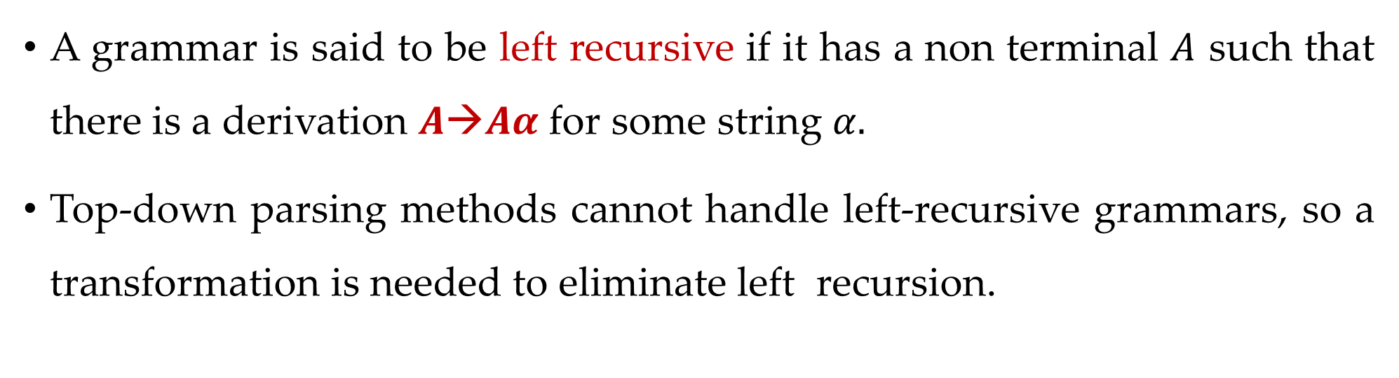
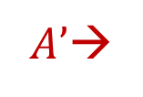


Left recursion
A grammar is said to be left recursive if it has a non terminal $A$ such that there is a derivation $A→Aα$for some string $α.$
Top-down parsing methods cannot handle left-recursive grammars, so a transformation is needed to eliminate left recursion.
$$A→Aα | β$$
$A→$
β$A’$
$|$𝜖
$A’$→
$$αA’$$

Slide 4
Examples: Left recursion elimination
E→E+T | T
E→TE’
E’→+TE’ | ε
T→T*F | F
T→FT’
T’→*FT’ | ε
X→X%Y | Z
X→ZX’
X’→%YX’ | ε

Slide 5
Exercise: Left recursion
A→Abd | Aa | a
B→Be | b
A→AB | AC | a | b
S→A | B
A→ABC | Acd | a | aa
B→Bee | b
Exp→Exp+term | Exp-term | term

Slide 6
Left factoring
Left factoring is a grammar transformation that is useful for producing a grammar suitable for predictive parsing.
S→aAB | aCD
S→aS’
S’→AB | CD
A→ xByA | xByAzA | a
A→ xByAA’ | a
A’→ Є | zA
A→ aAB | aA |a
A→aA’
A’→AB | A | 𝜖
A→aA’
A’→AA’’ | 𝜖
A’’→B | 𝜖

Slide 7
Exercise
S→iEtS | iEtSeS | a
A→ ad | a | ab | abc | x

Slide 8
Parsing
Parsing is a technique that takes input string and produces output either a parse tree if string is valid sentence of grammar, or an error message indicating that string is not a valid.
Types of parsing are:
Top down parsing: In top down parsing parser build parse tree from top to bottom.
Bottom up parsing: Bottom up parser starts from leaves and work up to the root.

Slide 9
Classification of parsing methods
Parsing
Top down parsing
Bottom up parsing (Shift reduce)
Back tracking
Operator precedence
Parsing without backtracking (predictive parsing)
LR parsing
SLR
LL(1)
CLR
Recursive
descent
LALR

Slide 10
Backtracking
In backtracking, expansion of nonterminal symbol we choose one alternative and if any mismatch occurs then we try another alternative.
Grammar: S→ cAd Input string: cad
A→ ab | a
S
S
S
c
A
d
c
A
d
c
A
d
Make prediction
Make prediction
a
b
Backtrack
a
Parsing done

Slide 11
Exercise
E→ 5+T | 3-T
T→ V | V*V | V+V
V→ a | b
String: 3-a+b

Slide 12
Parsing Methods
Parsing
Top down parsing
Bottom up parsing (Shift reduce)
Back tracking
Operator precedence
Parsing without backtracking (predictive parsing)
LR parsing
SLR
LL(1)
CLR
Recursive
descent
LALR

Slide 13
LL(1) parser (predictive parser)
LL(1) is non recursive top down parser.
First L indicates input is scanned from left to right.
The second L means it uses leftmost derivation for input string
1 means it uses only input symbol to predict the parsing process.
a | + | b | $
INPUT
X
Y
Z
$
Predictive parsing program
Stack
OUTPUT
Parsing table M

Slide 14
LL(1) parsing (predictive parsing)
Steps to construct LL(1) parser
Remove left recursion / Perform left factoring (if any).
Compute FIRST and FOLLOW of non terminals.
Construct predictive parsing table.
Parse the input string using parsing table.

Slide 15
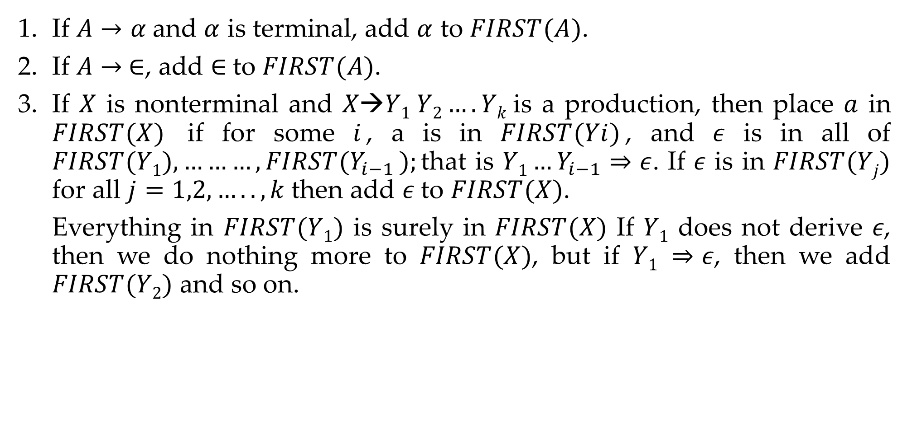
Rules to compute first of non terminal
If $A→α$and $α$ is terminal, add $α$ to $FIRST(A)$.
If $A→ ∈$, add $∈$to $FIRST(A)$.
If $X$ is nonterminal and $X→Y1 Y2….Yk$is a production, then place $a$ in $FIRST(X)$ if for some $i$, a is in $FIRST(Yi)$, and 𝜖 is in all of $FIRST(Y1),………,FIRST(Y_{i−1} );$that is $Y1…Y_{i−1}⇒ε$. If 𝜖 is in $FIRST(Yj)$ for all $j=1,2,…..,k$then add 𝜖 to $FIRST(X)$.
Everything in $FIRST(Y1)$ is surely in $FIRST(X)$ If $Y1$ does not derive 𝜖, then we do nothing more to $FIRST(X)$, but if $Y1 ⇒ε$, then we add $FIRST(Y2)$ and so on.

Slide 16
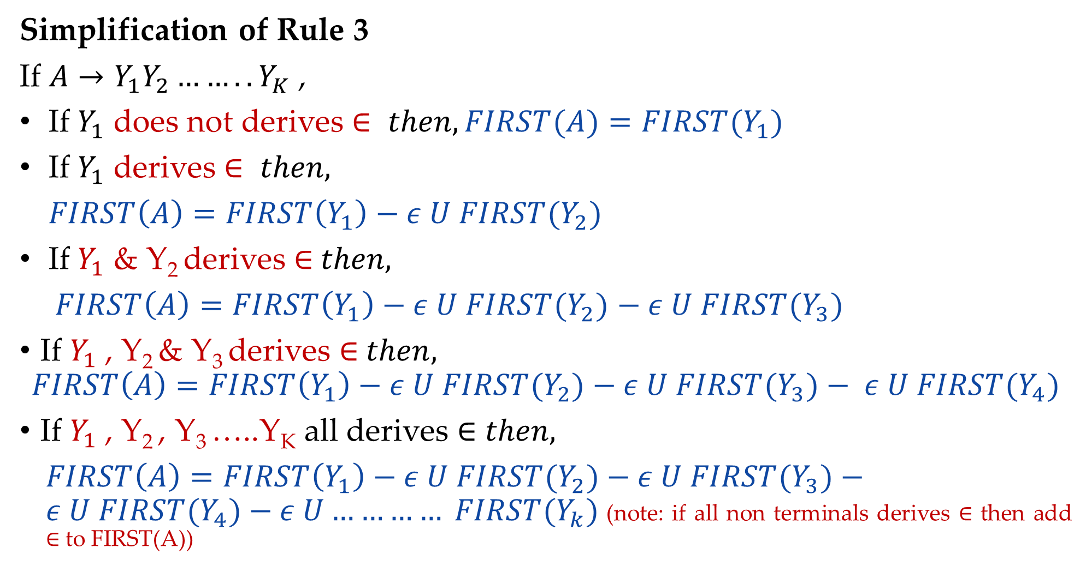
Rules to compute first of non terminal
Simplification of Rule 3
If $A→Y_{1}Y_{2}……..Y_{K}$ ,
If $Y_{1}$ does not derives $∈ then, FIRST(A)=FIRST{(Y}_{1})$
If $Y_{1}$ derives $∈ then,$
$FIRST\left(A\right)=FIRST\left(Y_{1}\right)−ε U FIRST{(Y}_{2})$
If $Y_{1}$ & Y₂ derives ∈$then,$
$FIRST\left(A\right)=FIRST\left(Y_{1}\right)−ε U FIRST{(Y}_{2})$ $− ε U FIRST{(Y}_{3})$
If $Y_{1}$ , Y₂ & Y₃ derives ∈$then,$
$$FIRST\left(A\right)=FIRST\left(Y_{1}\right)−ε U FIRST{(Y}_{2})−ε U FIRST{(Y}_{3})− ε U FIRST{(Y}_{4})$$
If $Y_{1}$ , Y₂ , Y₃ …..Y_{K} all derives ∈ $then,$
$FIRST\left(A\right)=FIRST\left(Y_{1}\right)−ε U FIRST{(Y}_{2})−ε U FIRST{(Y}_{3})−ε U FIRST{(Y}_{4})−ε U………… FIRST{(Y}_{k})$(note: if all non terminals derives ∈ then add ∈ to FIRST(A))

Slide 17

Rules to compute FOLLOW of non terminal
Place $\$ in follow\left(S\right). ($S is start symbol)
If $A→αBβ ,$then everything in $FIRST(β)$ except for 𝜖 is placed in $FOLLOW(B)$
If there is a production$A→αB$ or a production $A→αBβ$ where $FIRST(β)$ contains $ε$ then everything in $FOLLOW\left(A\right)−→FOLLOW\left(B\right)$

Slide 18

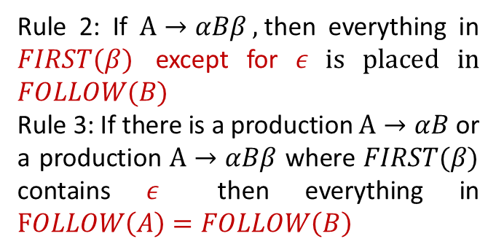










How to apply rules to find FOLLOW of non terminal?
$$A→αBβ$$
$$β is absent$$
$$β is present$$
$$Rule 3$$
$$β is terminal$$
$$β is Nonterminal$$
$$Rule 2$$
$β does not derives$ 𝜖
$β derives$ 𝜖
Rule 2: If $A→αBβ ,$then everything in $FIRST(β)$ except for 𝜖 is placed in $FOLLOW(B)$
Rule 3: If there is a production$A→αB$ or a production $A→αBβ$ where $FIRST(β)$ contains $ε$ then everything in $FOLLOW\left(A\right)=FOLLOW\left(B\right)$
$$Rule 2$$
$$Rule 2+Rule 3$$

Slide 19
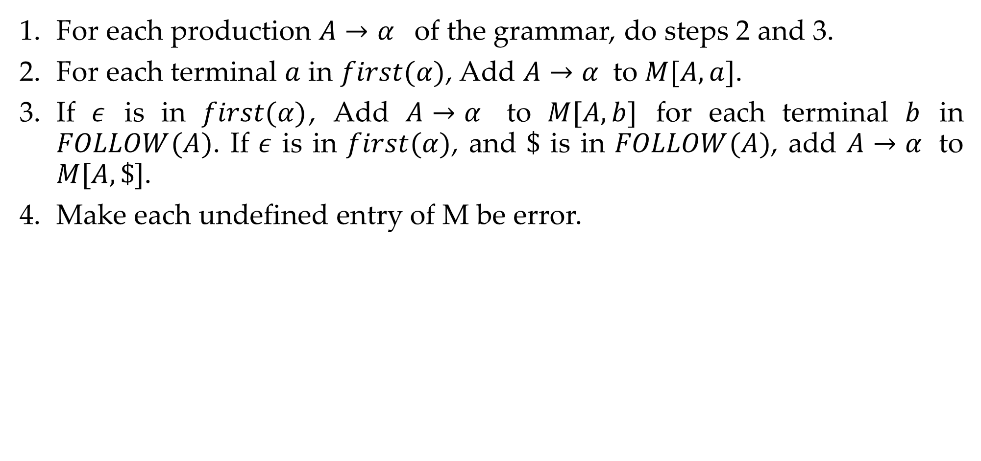
Rules to construct predictive parsing table
For each production $A→α$ of the grammar, do steps 2 and 3.
For each terminal $a$ in $first(α)$, Add $A→α$ to $M[A,a]$.
If $ε$ is in $first(α)$, Add $A→α$ to $M[A,b]$ for each terminal $b$ in $FOLLOW(A)$. If $ε$ is in $first(α)$, and $\$$ is in $FOLLOW(A)$, add $A→α$ to $M[A,\$]$.
Make each undefined entry of M be error.

Slide 20
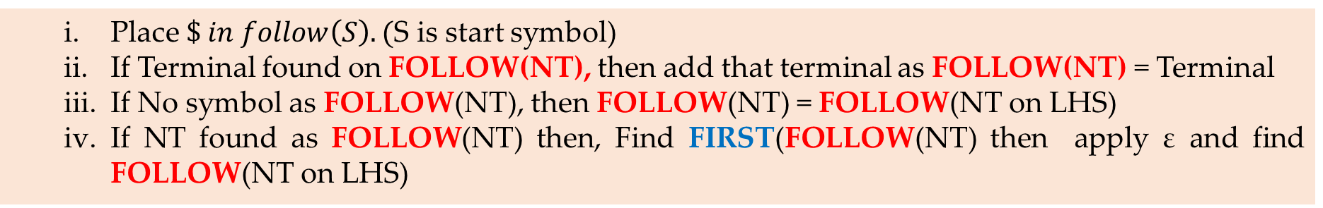
Steps to construct LL(1) parsing (predictive parsing)
Remove left recursion / Perform left factoring (if any).
Compute FIRST and FOLLOW of non terminals.
a. FIRST
If S-> aSBc, B-> ε then FIRST(S) ={a}, FIRST(B)={ε}
If A->Bxy, B->MN,M->z then FIRST(A)= FIRST(B)= FIRST(M)={z}
b. FOLLOW
Construct predictive parsing table.
Parse the input string using parsing table.
Place $\$ in follow\left(S\right). ($S is start symbol)
If Terminal found on FOLLOW(NT), then add that terminal as FOLLOW(NT) = Terminal
If No symbol as FOLLOW(NT), then FOLLOW(NT) = FOLLOW(NT on LHS)
If NT found as FOLLOW(NT) then, Find FIRST(FOLLOW(NT) then apply ε and find FOLLOW(NT on LHS)
For each N.T, if FIRST(NT) is not ε then for each symbols of FIRST(NT_{RHS}) update its production in the parsing table.
If FIRST(NT) is ε, the for each symbols of FOLLOW(NT_{LHS}) update its production in the parsing table.
Make each undefined entry of Parsing Table as error.

Slide 21






Example-1: LL(1) parsing
S→aBa
B→bB | ϵ
Step 1: Not required
Step 2: Compute FIRST
First(S)
S→aBa
First(B)
B→bB B→𝜖
NT | First
S | { a }
B | {b,𝜖}
S | → | a | B | a
Rule 1
add $α$ to $FIRST(A)$
A | → | $$α$$
FIRST(S)={ a }
B | → | b | B
B | → | 𝜖
Rule 1
add $α$ to $FIRST(A)$
A | → | $$α$$
A | → | $$ε$$
Rule 2
add $ε$ to $FIRST(A)$
FIRST(B)={ b
, 𝜖 }

Slide 22


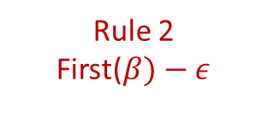
Example-1: LL(1) parsing
S→aBa
B→bB | ϵ
Step 2: Compute FOLLOW
Follow(S)
Follow(B)
S→aBa B→bB
NT | First | Follow
S | {a} | {$}
B | {b,𝜖} | {a}
Rule 1: Place $ in FOLLOW(S)
Follow(S)={ $ }
S | → | a | B | a
B | → | b | B
Rule 3
Follow(A)-->follow(B)
A | → | $$α$$ | B | $$β$$
Rule 2
First($β)−ε$
A | → | $$α$$ | B
Follow(B)={ a
}

Slide 23

Example-1: LL(1) parsing
S→aBa
B→bB | ϵ
Step 3: Prepare predictive parsing table
S→aBa
a=FIRST(aBa)={ a }
M[S,a]=S→aBa
NT | First | Follow
S | {a} | {$}
B | {b,𝜖} | {a}
NT | Input Symbol
 | a | b | $
S | S→aBa
B
Rule: 2
A→ $α$
a = first($α$)
M[A,a] = A→ $α$

Slide 24
Example-1: LL(1) parsing
S→aBa
B→bB | ϵ
Step 3: Prepare predictive parsing table
B→bB
a=FIRST(bB)={ b }
M[B,b]=B→bB
NT | First | Follow
S | {a} | {$}
B | {b,𝜖} | {a}
NT | Input Symbol
 | a | b | $
S | S→aBa
B |  | B→bB
Rule: 2
A→ $α$
a = first($α$)
M[A,a] = A→ $α$

Slide 25

Example-1: LL(1) parsing
S→aBa
B→bB | ϵ
Step 3: Prepare predictive parsing table
B→ϵ
b=FOLLOW(B)={ a }
M[B,a]=B→𝜖
NT | First | Follow
S | {a} | {$}
B | {b,𝜖} | {a}
NT | Input Symbol
 | a | b | $
S | S→aBa | Error | Error
B | B→ϵ | B→bB | Error
Rule: 3
A→ $α$
b = follow(A)
M[A,b] = A→ $α$

Slide 26




Example-2: LL(1) parsing
Step 1: Not required
Step 2: Compute FIRST
First(S)
S→aB S→𝜖
S→aB | ϵ
B→bC | ϵ
C→cS | ϵ
NT | First
S | { a, 𝜖 }
B | {b,𝜖}
C | {c,𝜖}
S | → | a | B
S | → | 𝜖
Rule 1
add $α$ to $FIRST(A)$
Rule 2
add $ε$ to $FIRST(A)$
A | → | $$α$$
A | → | $$ε$$
FIRST(S)={ a
, 𝜖 }

Slide 27
Example-2: LL(1) parsing
Step 1: Not required
Step 2: Compute FIRST
First(B)
B→bC B→𝜖
S→aB | ϵ
B→bC | ϵ
C→cS | ϵ
NT | First
S | { a, 𝜖 }
B | {b,𝜖}
C | {c,𝜖}
B | → | b | C
B | → | 𝜖
Rule 1
add $α$ to $FIRST(A)$
Rule 2
add $ε$ to $FIRST(A)$
A | → | $$α$$
A | → | $$ε$$
FIRST(B)={ b
, 𝜖 }

Slide 28
Example-2: LL(1) parsing
Step 1: Not required
Step 2: Compute FIRST
First(C)
C→cS C→𝜖
S→aB | ϵ
B→bC | ϵ
C→cS | ϵ
NT | First
S | { a, 𝜖 }
B | {b,𝜖}
C | {c,𝜖}
C | → | c | S
C | → | 𝜖
Rule 1
add $α$ to $FIRST(A)$
Rule 2
add $ε$ to $FIRST(A)$
A | → | $$α$$
A | → | $$ε$$
FIRST(B)={ c
, 𝜖 }

Slide 29



Example-2: LL(1) parsing
Step 2: Compute FOLLOW
Follow(S)
C→cS
B→bC S→aB
Rule 1: Place $ in FOLLOW(S)
Follow(S)={ $ }
S→aB | ϵ
B→bC | ϵ
C→cS | ϵ
C | → | c | S
Rule 3
Follow(A)→follow(B)
A | → | $$α$$ | B
Follow(S)=Follow(C)
={$}
NT | First | Follow
S | {a,𝜖} | {$}
B | {b,𝜖} | {$}
C | {c,𝜖} | {$}
B | → | b | C
Rule 3
Follow(A)→follow(B)
S | → | a | B
Rule 3
Follow(A)→follow(B)
A | → | $$α$$ | B
A | → | $$α$$ | B
Follow(C)=Follow(B)
={$}
Follow(B)=Follow(S)
={$}

Slide 30

Example-2: LL(1) parsing
Step 3: Prepare predictive parsing table
S→aB
a=FIRST(aB)={ a }
M[S,a]=S→aB
S→aB | ϵ
B→bC | ϵ
C→cS | ϵ
NT | First | Follow
S | {a,𝜖} | {$}
B | {b,𝜖} | {$}
C | {c,𝜖} | {$}
NT | Input Symbol
 | a | b | c | $
S | S→aB
B
C
Rule: 2
A→ $α$
a = first($α$)
M[A,a] = A→ $α$

Slide 31

Example-2: LL(1) parsing
Step 3: Prepare predictive parsing table
S→𝜖
b=FOLLOW(S)={ $ }
M[S,$]=S→𝜖
S→aB | ϵ
B→bC | ϵ
C→cS | ϵ
NT | First | Follow
S | {a} | {$}
B | {b,𝜖} | {$}
C | {c,𝜖} | {$}
NT | Input Symbol
 | a | b | c | $
S | S→aB |  |  | S→𝜖
B
C
Rule: 3
A→ $α$
b = follow(A)
M[A,b] = A→ $α$

Slide 32
Example-2: LL(1) parsing
Step 3: Prepare predictive parsing table
B→bC
a=FIRST(bC)={ b }
M[B,b]=B→bC
S→aB | ϵ
B→bC | ϵ
C→cS | ϵ
NT | First | Follow
S | {a} | {$}
B | {b,𝜖} | {$}
C | {c,𝜖} | {$}
NT | Input Symbol
 | a | b | c | $
S | S→aB |  |  | S→𝜖
B |  | B→bC
C
Rule: 2
A→ $α$
a = first($α$)
M[A,a] = A→ $α$

Slide 33
Example-2: LL(1) parsing
Step 3: Prepare predictive parsing table
B→𝜖
b=FOLLOW(B)={ $ }
M[B,$]=B→𝜖
S→aB | ϵ
B→bC | ϵ
C→cS | ϵ
NT | First | Follow
S | {a} | {$}
B | {b,𝜖} | {$}
C | {c,𝜖} | {$}
NT | Input Symbol
 | a | b | c | $
S | S→aB |  |  | S→𝜖
B |  | B→bC |  | B→𝜖
C
Rule: 3
A→ $α$
b = follow(A)
M[A,b] = A→ $α$

Slide 34
Example-2: LL(1) parsing
Step 3: Prepare predictive parsing table
C→cS
a=FIRST(cS)={ c }
M[C,c]=C→cS
S→aB | ϵ
B→bC | ϵ
C→cS | ϵ
NT | First | Follow
S | {a} | {$}
B | {b,𝜖} | {$}
C | {c,𝜖} | {$}
NT | Input Symbol
 | a | b | c | $
S | S→aB |  |  | S→𝜖
B |  | B→bC |  | B→𝜖
C |  |  | C→cS
Rule: 2
A→ $α$
a = first($α$)
M[A,a] = A→ $α$

Slide 35
Example-2: LL(1) parsing
Step 3: Prepare predictive parsing table
C→𝜖
b=FOLLOW(C)={ $ }
M[C,$]=C→𝜖
S→aB | ϵ
B→bC | ϵ
C→cS | ϵ
NT | First | Follow
S | {a} | {$}
B | {b,𝜖} | {$}
C | {c,𝜖} | {$}
NT | Input Symbol
 | a | b | c | $
S | S→aB | Error | Error | S→𝜖
B | Error | B→bC | Error | B→𝜖
C | Error | Error | C→cS | C→𝜖
Rule: 3
A→ $α$
b = follow(A)
M[A,b] = A→ $α$

Slide 36
Example-3: LL(1) parsing
E→E+T | T
T→T*F | F
F→(E) | id
Step 1: Remove left recursion
E→TE’
E’→+TE’ | ϵ
T→FT’
T’→*FT’ | ϵ
F→(E) | id

Slide 37




Example-3: LL(1) parsing
Step 2: Compute FIRST
First(E)
E→TE’
First(T)
T→FT’
First(F)
F→(E) F→id
E→TE’
E’→+TE’ | ϵ
T→FT’
T’→*FT’ | ϵ
F→(E) | id
E | → | T | E’
Rule 3
First(A)=First(Y1)
A | → | Y₁ | Y₂
FIRST(E)=FIRST(T)
= {(, id }
NT | First
E | { (,id }
T | → | F | T’
Rule 3
First(A)=First(Y1)
E’
A | → | Y₁ | Y₂
T | { (,id }
FIRST(T)=FIRST(F)
= {(, id }
T’
F | { (,id }
F | → | ( | E | )
F | → | id
A | → | $$α$$
Rule 1
add $α$ to $FIRST(A)$
A | → | $$α$$
Rule 1
add $α$ to $FIRST(A)$
FIRST(F)={ (
, id }

Slide 38





Example-3: LL(1) parsing
Step 2: Compute FIRST
First(E’)
E’→+TE’
E’→𝜖
E→TE’
E’→+TE’ | ϵ
T→FT’
T’→*FT’ | ϵ
F→(E) | id
E’ | → | + | T | E’
Rule 1
add $α$ to $FIRST(A)$
A | → | $$α$$
NT | First
E | { (,id }
E’ | { +, 𝜖 }
T | { (,id }
T’
E’ | → | $$ε$$
Rule 2
add $ε$ to $FIRST(A)$
F | { (,id }
A | → | $$ε$$
FIRST(E’)={ +
, 𝜖 }

Slide 39

Example-3: LL(1) parsing
Step 2: Compute FIRST
First(T’)
T’→*FT’
T’→𝜖
E→TE’
E’→+TE’ | ϵ
T→FT’
T’→*FT’ | ϵ
F→(E) | id
T’ | → | * | F | T’
Rule 1
add $α$ to $FIRST(A)$
A | → | $$α$$
NT | First
E | { (,id }
E’ | { +, 𝜖 }
T | { (,id }
T’ | { *, 𝜖 }
T’ | → | $$ε$$
Rule 2
add $ε$ to $FIRST(A)$
F | { (,id }
A | → | $$ε$$
FIRST(T’)={ *
, 𝜖 }

Slide 40

Example-3: LL(1) parsing
Step 2: Compute FOLLOW
FOLLOW(E)
F→(E)
E→TE’
E’→+TE’ | ϵ
T→FT’
T’→*FT’ | ϵ
F→(E) | id
Rule 1: Place $ in FOLLOW(E)
NT | First | Follow
E | { (,id } | { $,) }
E’ | { +, 𝜖 }
F | → | ( | E | )
Rule 2
T | { (,id }
A | → | $$α$$ | B | $$β$$
T’ | { *, 𝜖 }
F | { (,id }
FOLLOW(E)={ $,
) }

Slide 41


Example-3: LL(1) parsing
E→TE’
E’→+TE’ | ϵ
T→FT’
T’→*FT’ | ϵ
F→(E) | id
Step 2: Compute FOLLOW
FOLLOW(E’)
E→TE’
E’→+TE’
NT | First | Follow
E | → | T | E’
Rule 3
E | { (,id } | { $,) }
A | → | $$α$$ | B
E’ | { +, 𝜖 } | { $,) }
T | { (,id }
T’ | { *, 𝜖 }
F | { (,id }
E’ | → | +T | E’
Rule 3
A | → | $$α$$ | B
}
FOLLOW(E’)={ $,)

Slide 42


Example-3: LL(1) parsing
Step 2: Compute FOLLOW
FOLLOW(T)
E→TE’
E→TE’
E’→+TE’ | ϵ
T→FT’
T’→*FT’ | ϵ
F→(E) | id
NT | First | Follow
E | → |  | T | E’
Rule 2
E | { (,id } | { $,) }
A | → | $$α$$ | B | $$β$$
E’ | { +, 𝜖 } | { $,) }
T | { (,id }
T’ | { *, 𝜖 }
F | { (,id }
E | → |  | T | E’
Rule 3
A | → | $$α$$ | B | $$β$$
FOLLOW(T)={ +,
$, )

Slide 43


Example-3: LL(1) parsing
Step 2: Compute FOLLOW
FOLLOW(T)
E’→+TE’
E→TE’
E’→+TE’ | ϵ
T→FT’
T’→*FT’ | ϵ
F→(E) | id
NT | First | Follow
E’ | → | + | T | E’
Rule 2
E | { (,id } | { $,) }
A | → | $$α$$ | B | $$β$$
E’ | { +, 𝜖 } | { $,) }
T | { (,id } | { +,$,) }
T’ | { *, 𝜖 }
F | { (,id }
E’ | → | + | T | E’
Rule 3
A | → | $$α$$ | B | $$β$$
}
FOLLOW(T)={ +,
$, )

Slide 44


Example-3: LL(1) parsing
Step 2: Compute FOLLOW
FOLLOW(T’)
T→FT’
T’→*FT’
E→TE’
E’→+TE’ | ϵ
T→FT’
T’→*FT’ | ϵ
F→(E) | id
NT | First | Follow
T | → | F | T’
Rule 3
E | { (,id } | { $,) }
A | → | $$α$$ | B
E’ | { +, 𝜖 } | { $,) }
T | { (,id } | { +,$,) }
T’ | { *, 𝜖 } | { +,$,) }
F | { (,id }
T’ | → | *F | T’
Rule 3
A | → | $$α$$ | B
}
FOLLOW(T’)={+ $,)

Slide 45

Example-3: LL(1) parsing
Step 2: Compute FOLLOW
FOLLOW(F)
T→FT’
E→TE’
E’→+TE’ | ϵ
T→FT’
T’→*FT’ | ϵ
F→(E) | id
NT | First | Follow
T | → |  | F | T’
Rule 2
E | { (,id } | { $,) }
A | → | $$α$$ | B | $$β$$
E’ | { +, 𝜖 } | { $,) }
T | { (,id } | { +,$,) }
T’ | { *, 𝜖 } | { +,$,) }
F | { (,id }
T | → |  | F | T’
Rule 3
A | → | $$α$$ | B | $$β$$
FOLLOW(F)={ *,
+ ,$ , )

Slide 46
Example-3: LL(1) parsing
Step 2: Compute FOLLOW
FOLLOW(F)
T’→*FT’
E→TE’
E’→+TE’ | ϵ
T→FT’
T’→*FT’ | ϵ
F→(E) | id
NT | First | Follow
T’ | → | * | F | T’
Rule 2
E | { (,id } | { $,) }
A | → | $$α$$ | B | $$β$$
E’ | { +, 𝜖 } | { $,) }
T | { (,id } | { +,$,) }
T’ | { *, 𝜖 } | { +,$,) }
F | { (,id } | {*,+,$,)}
T’ | → | * | F | T’
Rule 3
A | → | $$α$$ | B | $$β$$
}
FOLLOW(F)={ *,+,
$, )

Slide 47
Example-3: LL(1) parsing
Step 3: Construct predictive parsing table
E→TE’
a=FIRST(TE’)={ (,id }
M[E,(]=E→TE’
M[E,id]=E→TE’
E→TE’
E’→+TE’ | ϵ
T→FT’
T’→*FT’ | ϵ
F→(E) | id
NT | Input Symbol
 | id | + | * | ( | ) | $
E | E→TE’ |  |  | E→TE’
E’
T
T’
F
NT | First | Follow
E | { (,id } | { $,) }
E’ | { +, 𝜖 } | { $,) }
T | { (,id } | { +,$,) }
T’ | { *, 𝜖 } | { +,$,) }
Rule: 2
A→ $α$
a = first($α$)
M[A,a] = A→ $α$
F | { (,id } | {*,+,$,)}

Slide 48
Example-3: LL(1) parsing
Step 3: Construct predictive parsing table
E’→+TE’
a=FIRST(+TE’)={ + }
M[E’,+]=E’→+TE’
E→TE’
E’→+TE’ | ϵ
T→FT’
T’→*FT’ | ϵ
F→(E) | id
NT | Input Symbol
 | id | + | * | ( | ) | $
E | E→TE’ |  |  | E→TE’
E’ |  | E’→+TE’
T
T’
F
NT | First | Follow
E | { (,id } | { $,) }
E’ | { +, 𝜖 } | { $,) }
T | { (,id } | { +,$,) }
T’ | { *, 𝜖 } | { +,$,) }
Rule: 2
A→ $α$
a = first($α$)
M[A,a] = A→ $α$
F | { (,id } | {*,+,$,)}

Slide 49
Example-3: LL(1) parsing
Step 3: Construct predictive parsing table
E’→𝜖
b=FOLLOW(E’)={ $,) }
M[E’,$]=E’→𝜖
M[E’,)]=E’→𝜖
E→TE’
E’→+TE’ | ϵ
T→FT’
T’→*FT’ | ϵ
F→(E) | id
NT | Input Symbol
 | id | + | * | ( | ) | $
E | E→TE’ |  |  | E→TE’
E’ |  | E’→+TE’ |  |  | E’→𝜖 | E’→𝜖
T
T’
F
NT | First | Follow
E | { (,id } | { $,) }
E’ | { +, 𝜖 } | { $,) }
T | { (,id } | { +,$,) }
T’ | { *, 𝜖 } | { +,$,) }
Rule: 3
A→ $α$
b = follow(A)
M[A,b] = A→ $α$
F | { (,id } | {*,+,$,)}

Slide 50
Example-3: LL(1) parsing
Step 3: Construct predictive parsing table
T→FT’
a=FIRST(FT’)={ (,id }
M[T,(]=T→FT’
M[T,id]=T→FT’
E→TE’
E’→+TE’ | ϵ
T→FT’
T’→*FT’ | ϵ
F→(E) | id
NT | Input Symbol
 | id | + | * | ( | ) | $
E | E→TE’ |  |  | E→TE’
E’ |  | E’→+TE’ |  |  | E’→𝜖 | E’→𝜖
T | T→FT’ |  |  | T→FT’
T’
F
NT | First | Follow
E | { (,id } | { $,) }
E’ | { +, 𝜖 } | { $,) }
T | { (,id } | { +,$,) }
T’ | { *, 𝜖 } | { +,$,) }
Rule: 2
A→ $α$
a = first($α$)
M[A,a] = A→ $α$
F | { (,id } | {*,+,$,)}

Slide 51
Example-3: LL(1) parsing
Step 3: Construct predictive parsing table
T’→*FT’
a=FIRST(*FT’)={ * }
M[T’,*]=T’→*FT’
E→TE’
E’→+TE’ | ϵ
T→FT’
T’→*FT’ | ϵ
F→(E) | id
NT | Input Symbol
 | id | + | * | ( | ) | $
E | E→TE’ |  |  | E→TE’
E’ |  | E’→+TE’ |  |  | E’→𝜖 | E’→𝜖
T | T→FT’ |  |  | T→FT’
T’ |  |  | T’→*FT’
F
NT | First | Follow
E | { (,id } | { $,) }
E’ | { +, 𝜖 } | { $,) }
T | { (,id } | { +,$,) }
T’ | { *, 𝜖 } | { +,$,) }
Rule: 2
A→ $α$
a = first($α$)
M[A,a] = A→ $α$
F | { (,id } | {*,+,$,)}

Slide 52
Example-3: LL(1) parsing
Step 3: Construct predictive parsing table
T’→𝜖
b=FOLLOW(T’)={ +,$,) }
M[T’,+]=T’→𝜖
M[T’,$]=T’→𝜖
M[T’,)]=T’→𝜖
E→TE’
E’→+TE’ | ϵ
T→FT’
T’→*FT’ | ϵ
F→(E) | id
NT | Input Symbol
 | id | + | * | ( | ) | $
E | E→TE’ |  |  | E→TE’
E’ |  | E’→+TE’ |  |  | E’→𝜖 | E’→𝜖
T | T→FT’ |  |  | T→FT’
T’ |  | T’→𝜖 | T’→*FT’ |  | T’→𝜖 | T’→𝜖
F
NT | First | Follow
E | { (,id } | { $,) }
E’ | { +, 𝜖 } | { $,) }
T | { (,id } | { +,$,) }
T’ | { *, 𝜖 } | { +,$,) }
Rule: 3
A→ $α$
b = follow(A)
M[A,b] = A→ $α$
F | { (,id } | {*,+,$,)}

Slide 53
Example-3: LL(1) parsing
Step 3: Construct predictive parsing table
F→(E)
a=FIRST((E))={ ( }
M[F,(]=F→(E)
E→TE’
E’→+TE’ | ϵ
T→FT’
T’→*FT’ | ϵ
F→(E) | id
NT | Input Symbol
 | id | + | * | ( | ) | $
E | E→TE’ |  |  | E→TE’
E’ |  | E’→+TE’ |  |  | E’→𝜖 | E’→𝜖
T | T→FT’ |  |  | T→FT’
T’ |  | T’→𝜖 | T’→*FT’ |  | T’→𝜖 | T’→𝜖
F |  |  |  | F→(E)
NT | First | Follow
E | { (,id } | { $,) }
E’ | { +, 𝜖 } | { $,) }
T | { (,id } | { +,$,) }
T’ | { *, 𝜖 } | { +,$,) }
Rule: 2
A→ $α$
a = first($α$)
M[A,a] = A→ $α$
F | { (,id } | {*,+,$,)}

Slide 54
Example-3: LL(1) parsing
Step 3: Construct predictive parsing table
F→id
a=FIRST(id)={ id }
M[F,id]=F→id
E→TE’
E’→+TE’ | ϵ
T→FT’
T’→*FT’ | ϵ
F→(E) | id
NT | Input Symbol
 | id | + | * | ( | ) | $
E | E→TE’ |  |  | E→TE’
E’ |  | E’→+TE’ |  |  | E’→𝜖 | E’→𝜖
T | T→FT’ |  |  | T→FT’
T’ |  | T’→𝜖 | T’→*FT’ |  | T’→𝜖 | T’→𝜖
F | F→id |  |  | F→(E)
NT | First | Follow
E | { (,id } | { $,) }
E’ | { +, 𝜖 } | { $,) }
T | { (,id } | { +,$,) }
T’ | { *, 𝜖 } | { +,$,) }
Rule: 2
A→ $α$
a = first($α$)
M[A,a] = A→ $α$
F | { (,id } | {*,+,$,)}

Slide 55
Example-3: LL(1) parsing
Step 4: Make each undefined entry of table be Error
NT | Input Symbol
 | id | + | * | ( | ) | $
E | E→TE’ | Error | Error | E→TE’ | Error | Error
E’ | Error | E’→+TE’ | Error | Error | E’→𝜖 | E’→𝜖
T | T→FT’ | Error | Error | T→FT’ | Error | Error
T’ | Error | T’→𝜖 | T’→*FT’ | Error | T’→𝜖 | T’→𝜖
F | F→id | Error | Error | F→(E) | Error | Error

Slide 56
Example-3: LL(1) parsing
Step 5: Parse the string : id + id * id $
NT | Input Symbol
 | id | + | * | ( | ) | $
E | E→TE’ | Error | Error | E→TE’ | Error | Error
E’ | Error | E’→+TE’ | Error | Error | E’→𝜖 | E’→𝜖
T | T→FT’ | Error | Error | T→FT’ | Error | Error
T’ | Error | T’→𝜖 | T’→*FT’ | Error | T’→𝜖 | T’→𝜖
F | F→id | Error | Error | F→(E) | Error | Error
STACK | INPUT | OUTPUT
E$ | id+id*id$
TE’$ | id+id*id$ | E→TE’
FT’E’$ | id+id*id$ | T→FT’
idT’E’$ | id+id*id$ | F→id
T’E’$ | +id*id$
E’$ | +id*id$ | T’→𝜖
+TE’$ | +id*id$ | E’→+TE’
TE’$ | id*id$
FT’E’$ | id$
FT’E’$ | id*id$ | T→FT’
idT’E’$ | id$ | F→id
idT’E’$ | id*id$ | F→id
T’E’$ | $
T’E’$ | *id$
E’$ | $ | T’→𝜖
*FT’E’$ | *id$ | T→*FT’
$ | $ | E’→𝜖

Slide 57
Exercise
Construct parsing table for the following grammar:
S -> aABb
A -> c | €
B -> d | €
Construct parsing table for the following grammar:
S -> AaAb | BbBa
A -> €
B -> €
Construct parsing table for the following grammar:
S -> AB |eDa
A -> ab |c
B -> dC
C -> eC | €
D -> fD | €

Slide 58
Solution to Ex: 1
S -> aABb A -> c | € B -> d | €
Step: 1: No left recursion in the grammar, hence no modification required.
Step 2: Calculation of First Set
First(S) = {a}
First(A) = {c, €}
First(B) = {d, €}

Slide 59
Step 3: Calculation of Follow Set Follow(S) = {$}
Follow(A) = First(Bb) = First(B) = {d, €)
Since it contains €, continue FIRST rule. First(Bb) = First(B) - € U First (b) = {d, b} Follow(A) = {d,b}
Follow(B)= {b}
Step 4: Parsing Table
Grammar is LL(1)
Example String: acdb$ H/w string: adb$
 | a | b | c | d | $
S | S->aABb
A |  | A->€ | A->c | A->€
B |  | B->€ |  | B->d

Slide 60
Example String: acdb$
 | a | b | c | d | $
S | S->aABb
A |  | A->€ | A->c | A->€
B |  | B->€ |  | B->d
Stack | Input | Action
$ | acdb$ | Push S into Stack
$S | acdb$ | S->aABb
$bBAa | acdb$ | Pop a
$bBA | cdb$ | A->c
$bBc | cdb$ | Pop c
$bB | db$ | B->d
$bd | db$ | Pop d
$b | b$ | Pop b
$ | $ | Accept

Slide 61
Solution to Ex: 2
S -> AaAb | BbBa
A -> €
B -> €
Step: 1: No left recursion in the grammar, hence no modification required.
Step 2: Calculation of First Set First(S) = First(AaAb) U First(BbBa) First(AaAb) = First(A) = €
Since it contains €, continue FIRST rule First(AaAb) = First(A) - € U First(aAb) = {a} Similarly: First(BbBa) = {b}
First(S) = {a,b}

Slide 62
Step 3: Calculation of Follow Set Follow(S) = {$}
Follow(A) = First(aAb) = a
Follow(A) = {a,b}
Similarly,
Follow(B) = {a,b}
Step 4:Construction of Parsing Table: Grammar is LL(1)
Follow(A) = First(b) = {b}
 | a | b | $
S | S->AaAb | S->BbBa
A | A->€ | A->€
B | B->€ | B->€

Slide 63
Solution to Ex: 3
S -> AB |eDa
A -> ab |c
B -> dC
C -> eC | €
D -> fD | €
Step: 1: No left recursion in the grammar, hence no modification required.
Step 2: Calculation of First Set
First(S) = {a,c,e}
First(A) = {a,c}
First(B) = {d}
First(C) = {e, €}
First(D) = {f, €}

Slide 64
Step 3: Calculation of Follow Set
Follow(S) = {$}
S->AB
Follow(A) = First(B) = {d} Follow(B) = Follow(S) = {$}
S->eDA
Follow(D) = First(a) = {a}
B->dC
Follow(C) = Follow(B) = {$}
C->eC
Follow(C) = Follow(C) = {$}
D->fD
Follow(D) = Follow(D) = {a}
Parsing Table
 | a | b | c | d | e | f | $
S | S->AB |  | S->AB |  | S->eDa
A | A->ab |  | A->c
B |  | B->dC
C |  |  |  |  | C->eC |  | C->€
D | D->€ |  |  |  |  | D->fD

Slide 65
Parsing methods
Parsing
Top down parsing
Bottom up parsing (Shift reduce)
Back tracking
Operator precedence
Parsing without backtracking (predictive parsing)
LR parsing
SLR
LL(1)
CLR
Recursive
descent
LALR

Slide 66
Recursive descent parsing
A top down parsing that executes a set of recursive procedure to process the input without backtracking is called recursive descent parser.
There is a procedure for each non terminal in the grammar.
Consider RHS of any production rule as definition of the procedure.
As it reads expected input symbol, it advances input pointer to next input position.
The term descent refers to the direction in which the parse tree is built.
It builds the parse tree from the root to the leaf.

Slide 67
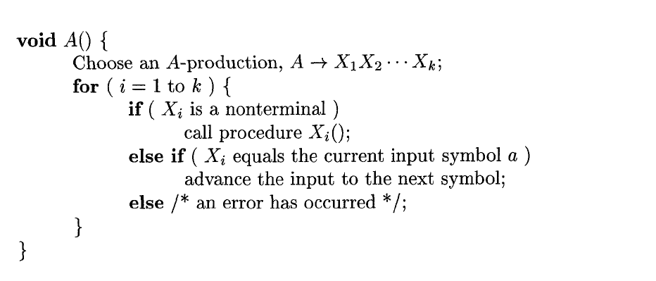
Cont.,

Slide 68
Example: Recursive descent parsing
Procedure E
{
If lookahead=num
{
Match(num);
T();
}
Else
Error();
If lookahead=$
{
Declare success;
}
Else
Error();
}
Procedure T
{
If lookahead=’*’
{
Match(‘*’);
If lookahead=num
{
Match(num);
T();
}
Else
Error();
}
Else
NULL
}
Proceduce Match(token t)
{
If lookahead=t
lookahead=next_token;
Else
Error();
}
Procedure Error
{
Print(“Error”);
}
E→
T→
num
T
num
| 𝜖
*
T
3 | * | 4 | $
Success

Slide 69
Example: Recursive descent parsing
Procedure E
{
If lookahead=num
{
Match(num);
T();
}
Else
Error();
If lookahead=$
{
Declare success;
}
Else
Error();
}
Procedure T
{
If lookahead=’*’
{
Match(‘*’);
If lookahead=num
{
Match(num);
T();
}
Else
Error();
}
Else
NULL
}
Proceduce Match(token t)
{
If lookahead=t
lookahead=next_token;
Else
Error();
}
Procedure Error
{
Print(“Error”);
}
E→
T→
num
T
num
| 𝜖
*
T
3 | * | 4 | $
Success
3 | 4 | * | $
Error

Slide 70
Example 2
Write down the algorithm using Recursive procedures to implement the following Grammar.
E → TE′
E′ → +TE′
T → FT′
T′ →∗ FT′|ε
F → (E)|id

Slide 71
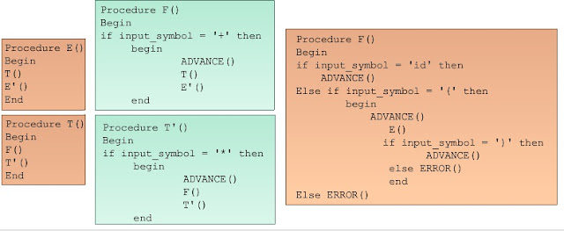

Slide 72
Solution:
Procedure E()
{ T()
E’()
if lookahead = $
declare success
else
Error()
}
Procedure E’()
{ if lookahead = +
{ match(+)
T()
E’()
}
else
NULL
}
Procedure T’()
{ if lookahead = *
{ match(*)
F()
T’()
}
else
NULL
}
Procedure T()
{ F()
T’()
}

Slide 73
Cont…
Procedure F()
{
If lookahead == id
{ match(id) }
Else if lookahead == ‘(‘
{ match(‘(‘)
E()
if lookahead == ‘)’
match(‘)’)
else
Error()
}
Else { Error() }
}
Proceduce Match(token t)
{
If lookahead=t
lookahead=next_token;
Else
Error();
}
Procedure Error
{
Print(“Error”);
}

